Slide 1
Memory Management No Memory Abstraction

Slide 2
Review
Process Model
Pseudo-parallelism (Multi-programming, quantum or time slice)
Context Switch (user mode ↔ kernel mode, switch CPU to other process – load/store PCB)
Scheduling algorithm
Batch
FCFS: non-preemptive, process enters ready state first, it will get CPU first, event occurs when the process is terminal state, convey effect
SJF: non-preemptive, the scheduler picks the shorted job first, event occurs when the process is terminal state, optimal algorithms but it not realism
SRT: preemptive, the scheduler chooses the process whose remaining runtime is the shortest, event occurs when the process is new (priority) or terminal
Interactive
RR: preemptive, A process can hold the CPU for a maximum of quantum, event occurs when the process is process ending quantum or terminal, FCFS or context switch
Priority Scheduling: 4 class 1 – 4 that use any scheduling with statically or dynamic priority, the greatest priority runnable process is always run, starvation (aging)
SPT: non-preemptive, estimate the next value in a series by taking the weighted average of the current measured value and the previous estimate then applying to SJF
Multiple Queues, Guaranteed Scheduling, Lottery Scheduling, Fair-Share Scheduling
Real time: meeting deadline

Slide 3
Review
PCB
Id, registers, scheduling information, memory management information, accounting information, I/O status information, …
State (New, Running, Ready, Blocked, Terminal)
CPU Utilization
Shows the CPU utilization
1 – p^{n}
Threads
Share the same address space and resources of the process
Each thread has its own PC, registers and stack of execution
There is no protection between threads in one process
Have its own stack
Improve context switch among processes, optimize quantum
Are implemented in 3 modes: user, kernel, hybrid
Scheduling: same as process in 3 modes combination

Slide 4
Review
IPC
Resolving
Race condition (Critical Region)
Busy waiting (Priority Inversion)
Good solution for race condition
Software: Peterson solution (2 control variables)
Hardware: TSL (atomically, individual)
Good solution for race condition and busy waiting
Software: binary semaphore (recommending about order in using), monitors
Hardware: mutexes
With multiple process
Dinning Philosopher problems: starvation, deadlock → array of semaphore
Readers and Writer problems:
No reader will be kept waiting
Only writer can be written

Slide 5
Review
Scheduling
Scheduler component
Event: creation, termination, blocking, Interrupt
Type: non-preemptive, preemptive
Criteria
Fairness, Policy enforcement, Throughput, Turnaround time, CPU utilization, Response time, Proportionality
Turnaround time: terminal time – ready time
Waiting time: ∑ (running time – ready/blocked time)
Process
State (New, Running, Ready, Blocked, Terminal)
Behavior (Compute-bound, I/O-bound)
Address Spaces
The abstraction that is referenced to the set of addresses a process (The address of process is always calculated from 0)

Slide 6
Objectives
Overview
No Memory Abstraction
Simplest
Multiple programming

Slide 7
Overview
The need for a memory to be
infinitely large
infinitely fast
nonvolatile
Types of memory hierarchy
A few MBs/GBs, very fast and expensive, volatile cache memory
A few GBs, medium-speed, medium-price, volatile main memory (RAM)
A few TBs of slow, cheap, nonvolatile disk storage
Memory Manager
The part of the OS manages (part of) the memory hierarchy
It jobs as
coordinate how the different types of memory are used
keep track of which part of memory are in use and which are not
allocate and release areas of main memory to processes
manage swapping between main memory and disk, when main memory is too small to hold all the processes

Slide 8
No Memory Abstractions
Simplest
Is no abstraction at all
Mainframe computer (before 1960), early minicomputers (before 1970), and early PC (before 1980)
No swapping or paging
Run only one program at a time
In memory are loaded the only program that is run the OS
Way of memory organization
OS at the bottom of memory and the user program above
OS at the top of memory (ROM) and the user program bellow
OS at the bottom of memory, device drivers in ROM (mapped at the top of memory – BIOS) and the user program between them

Slide 9
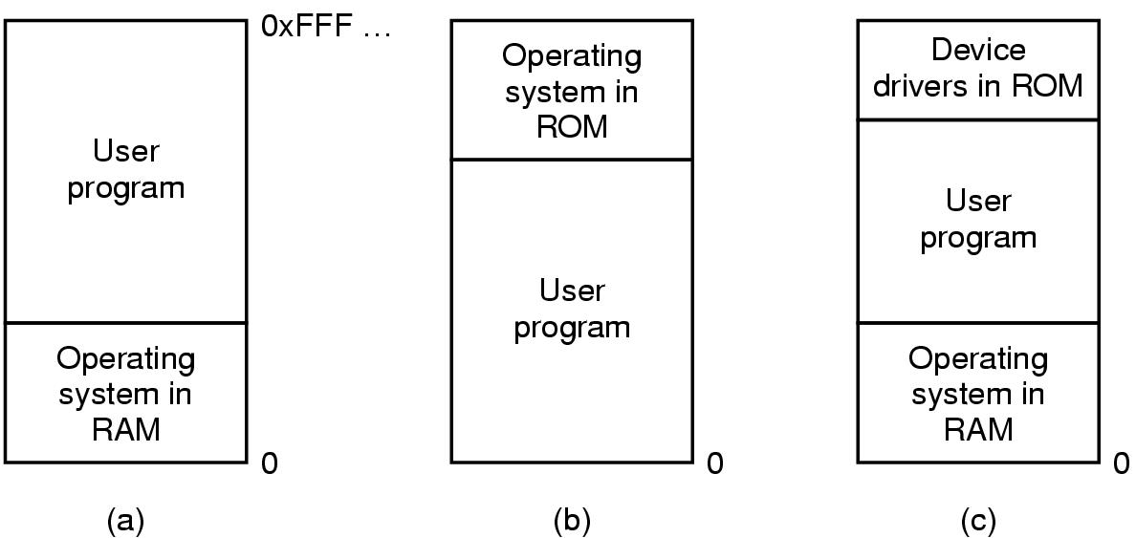
No Memory Abstractions
Simplest
Tanenbaum, Fig. 3-1.
Locate at bottom in RAM
Mainframes, minicomputer
Locate at top in ROM
Handheld, embedded
Locate at bottom in RAM, device drives locate at top in ROM
PC

Slide 10
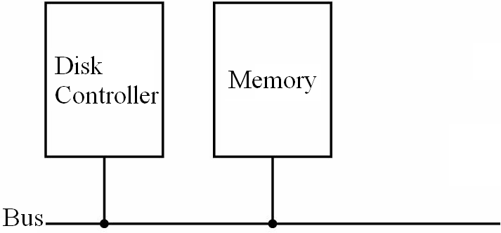
No Memory Abstractions
Simplest
Protection is needed
Solution
Using the special register stores the highest address of OS (in the other words, the address is less than the lowest address of user program)
In runtime, the accessing must be checking via the special register.
If the accessing address is larger than the special register values, the access is accepted
Otherwise, the interrupt occurs to intercept
Disadvantages
The special register is created
Slow
Special Register stores limit addr
Real address
>
True
False
Real address
Address error; trap/ interrupt

Slide 11
No Memory Abstractions
Multiple Programs
It is possible to run multiple programs at the same time
The OS saves the entire contents of memory to a disk file, then bring in and run the next program
Solution
Memory was divided into fixed size block and each one was assigned a fixed bit protection key held in special registers inside the CPU
Protect the code of OS against the processes
Protect one process against other processes
Problem:
Internal fragmentation.
After the programs are loaded to run, the two programs both reference absolute physical memory → we want each program to reference a private set of addresses local to it. Number of programs are limited.

Slide 12
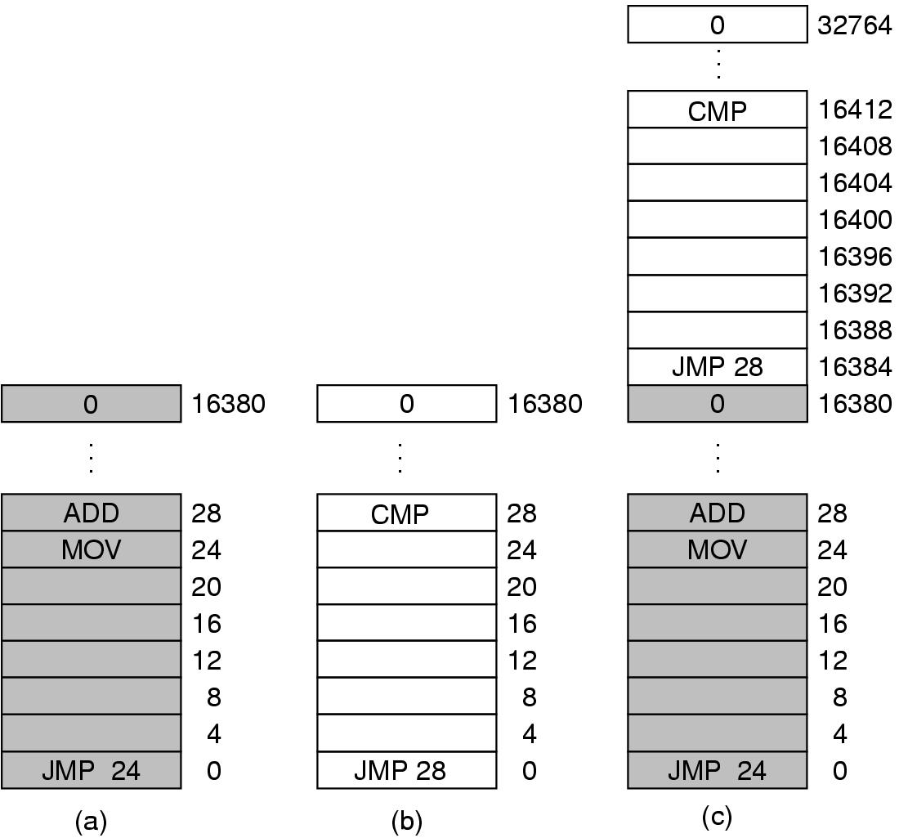
No Memory Abstractions
Multiple Programs
Tanenbaum, Fig. 3-2.

Slide 13
No Memory Abstractions
Multiple Programs
Solution: Static relocation technique
At the compile time, the address of program is a relative addresses.
At the time when the program is loaded into the memory at address n, the constant n was added to every program address during the load process
→ After loaded, the process cannot change its location in memory (static address)
→ Slow down loading
→ Not protection inside process
Loaded address n
Relative address
+
To load at real added addresses

Slide 14
Next Lecture
A Memory Abstraction

Slide 15
Memory Management Memory Abstraction Address Space

Slide 16
Review
Memory Manager
coordinate how the different types of memory are used
keep track memory to allocate and release areas of main memory to processes
manage swapping between main memory and disk
No Memory Abstractions
Single program
One OS, only one process
Special register is used to protection between OS and process
Disadvantages: slow
Multiple program:
Divided into fixed size block
Disadvantages
Internal fragmentations
Two programs both reference absolute physical memory → static relocation

Slide 17
Objectives
A Memory Abstraction
Address Space
Base and Limit Registers
Swapping
Memory Management with Bitmaps
Memory Management with Linked Lists
Virtual Memory
Problems

Slide 18
A Memory Abstraction
Address space
Is the abstraction that is referenced to the set of addresses for a process
Is the set of addresses that a process can use to address memory
Is decoupled from the physical memory (larger or smaller)
Is a very general concept and occurs in many contexts
Do not have to be numeric (ex: .com Internet domain)

Slide 19
A Memory Abstraction
Base and Limit Registers
Issues
Multiple programs (processes)
To ensure correct operation in order to protect the operating system from access by user processes and to protect user processes from one another
Each process has a range of legal addresses.
Process can access only these legal addresses
Improve static relocation
Solution
Give a two supplementary registers into the hardware
Base register: hold the physical address where the program begins in memory.
Limit register: specify the length of program
When the process is allocated in the memory
The base register loads the physical address where the program begins
The limit register loads the length of process
The address of process is relative (that is not compiled)
Every time, a process references memory,
The CPU hardware automatically adds the base register’s value to the address generated by the process to generate the real address
Simultaneously, it checks if the address offered is equal to or greater than the value in the limit register, in which case a fault is generated and the access is aborted.

Slide 20
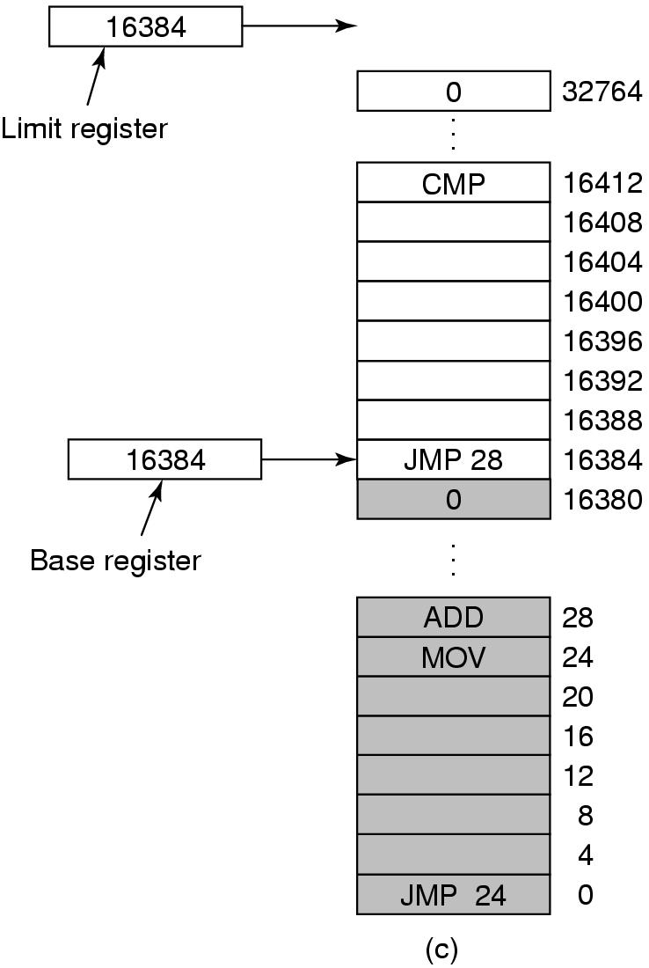
A Memory Abstraction
Base and Limit Registers
Limit Register
Base Register
True
Relative address
<
+
False
Real address
Address error; trap/ interrupt
Tanenbaum, Fig. 3-3.

Slide 21
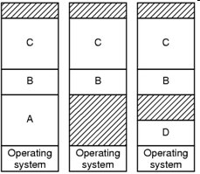
A Memory Abstraction
Base and Limit Registers
This solution is an easy way to give each process its own private address space.
Advantages
The process can move to new location in the memory at runtime
When it moves, the base register’s value is reloaded
Disadvantages
Need to perform an addition and a comparison on every memory reference (update the registers’ value when the location of memory changes)

Slide 22
A Memory Abstraction
Swapping
The reason
No more space in memory to keep all the active processes
Keeping all processes in memory all the time requires a huge amount of memory and cannot be done if there is insufficient memory
The simplest strategy is swapping
Bringing in each process in its entirety, running it for a while, then putting it back on the disk
Operation
swap out (memory → HDD)
swap in (memory ← HDD)
At one moment, a process is entirely in the memory to be run or entirely on the HDD

Slide 23
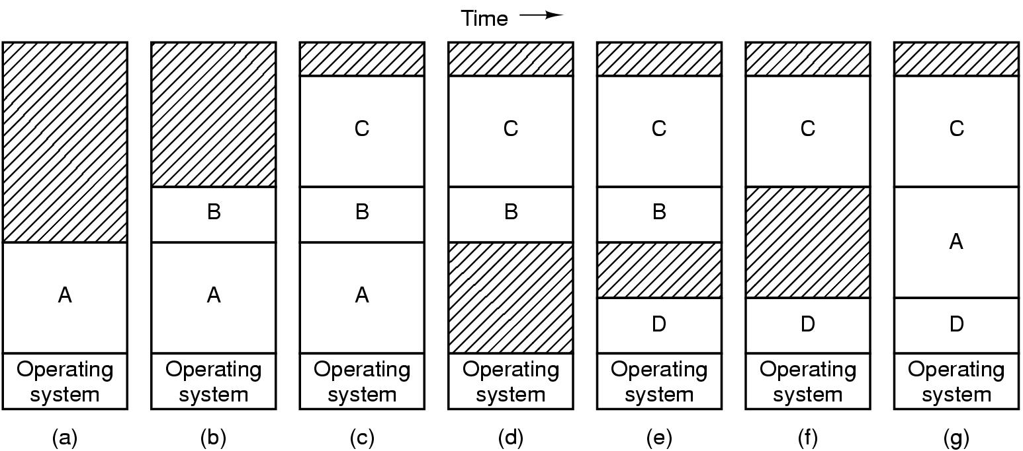
A Memory Abstraction
Swapping
Tanenbaum, Fig. 3-4.

Slide 24
A Memory Abstraction
Swapping
Memory compaction technique (external defragment/ compaction)
When swapping creates multiple holes in memory, it is possible to combine all into one big one by moving all the processes downward as far as possible
Disadvantages: slow and complexity (the addresses are changed and updated)
If processes are created with fixed size that never changes, the OS allocates exactly what is needed
Problem: the processes’ data segments can grow →
If the process is adjacent to another process, the growing process will either have to be moved to a hole on memory large enough for it, or one or more processes will have to be swapped out to create a large enough hole
If a process can not grow in memory and the swap area on the disk is full, the process will have to suspended until some space is freed up (or it can be killed)

Slide 25
A Memory Abstraction
Swapping
Solutions
Allocate a little extra memory (!?) whenever a process is swapped in or moved
Others
Each process has a stack of top of its allocated memory that is growing downward
A data segment just beyond the program text that is growing upward
The memory between them can be used for either segment.
If it runs out, the process will either have to be moved to a hole with sufficient space swapped out of memory until a large enough hole can be created, or killed

Slide 26
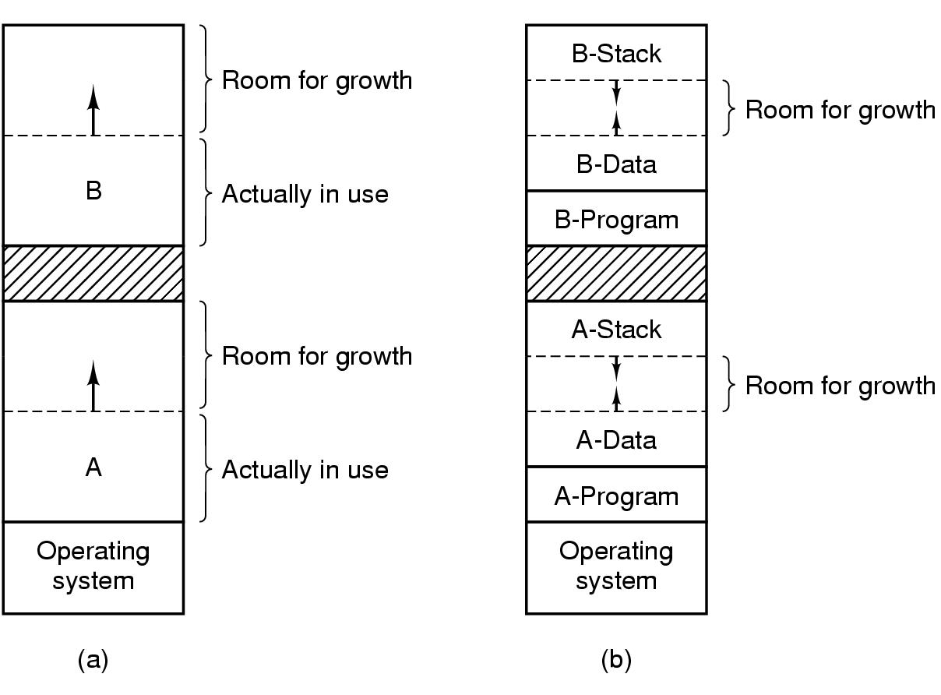
A Memory Abstraction Swapping
Tanenbaum, Fig. 3-5.

Slide 27
A Memory Abstraction Memory Management with Bitmaps
The memory is divided up into allocation units of the same size
Each allocation unit has a bit corresponding bit in the bitmap
0 → the unit is free
1 → the unit is occupied
The size of the allocation unit is an important design issue
The smaller the size, the greater the bitmap
The greater the size, the smaller the bitmap, but results in waste of memory (internal fragmentation)
A Bitmap provides a simple way to keep track memory words in a fixed amount of memory because the size of the bitmap depends only on the size of memory and the allocation units

Slide 28
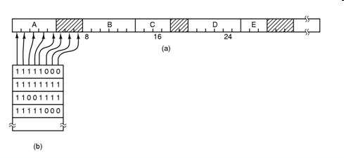
A Memory Abstraction Memory Management with Bitmaps
Tanenbaum, Fig. 3-6.
Problem: when it has been decided to bring a k unit process into memory, the memory manager must search the bitmap to find a run of k consecutive 0 bits in the map → slow

Slide 29
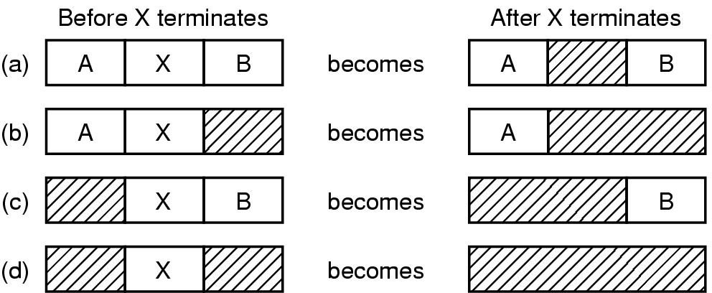
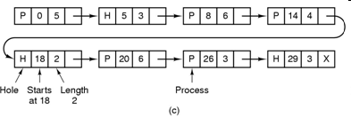
A Memory Abstraction Memory Management with Linked Lists
Maintain a linked list of allocated and free memory segments, where a segment either contains a process or is an empty hole between two processes, to keep track of memory
Each entry in the list specifies
a hole (H) or process (P)
the address at which its starts
The length
The pointer to the next entry
List sorted by the memory address
updating the list is simple and fast

Slide 30
A Memory Abstraction Memory Management with Linked Lists
Allocation of memory
First fit – fast
The memory manager scans along the list of segments until it finds a hole that a big enough
The hole is then broken up into pieces, one for the process and one for the unused memory
Next fit – slightly worse performance than first fit
Works same as first fit except that it keep tracks of where it is whenever it finds a suitable hole
The next time it is called to find a hole, it starts searching the list from the place where it left off last time, instead of always at the beginning
Best fit – slower; tends to fill up memory with tiny, useless holes
Search the entire list, from beginning to end, and takes the smallest hole that is adequate
Rather than breaking up a big hole that might be needed later, best fit tries to find a hole that is close to the actual size needed, to best match the request and the available holes
Worst fit – is not a very good idea
Take a largest available hole, so that the new hole will be big enough to be useful

Slide 31
A Memory Abstraction Memory Management with Linked Lists
8K
8K
12K
First Fit
12K
22K
Best Fit
6K
Last
allocated
block (14K)
18K
2K
Memory direct access
8K
8K
6K
6K
Allocated block
Free block
14K
14K
Next Fit
36K
20K
Before
After
Allocate to block (16K) using First Fit, Best Fit, or Next Fit

Slide 32
A Memory Abstraction Memory Management with Linked Lists
Separate lists for processes and holes
Speed up searching for a hole at allocation
Complicates releasing of memory (additional complexity and slowdown because a freed segment has to be removed from the process list and inserted into the hole list)
Holes list can be sorted by the size (to make best fit faster same as first fit)
A small optimization is possible. Instead of having a separate set of data structures maintaining the hole list, the information can be stored in the holes (the first word hold hole size, the second word a pointer to the following entry)
Quick fit
Finding a hole of the required size is extremely fast, but it has the same disadvantage as all schemes that sort by hole size, namely, when process terminates or is swapped out, finding its neighbors to see if a merge is possible expensive
If merging is not done, memory quickly gets fragmented into a large number of small holes into which no process fits

Slide 33
Virtual Memory Problems
Managing bloat ware
While memory sizes are increasing rapidly, software sizes are increasing much faster
There is need to run programs that are too large to fit in memory, and there is certainly a need to have a systems that can support multiple programs run simultaneously
Swapping is not an attractive option (SATA disk)
SATA == Serial Advanced Technology Attachment
Solutions
Keep in memory only the program of instructions and data (a part of program, not entire program) that are needed at any given time
When other instructions are needed, they are loaded into space occupied previously by instructions that are no longer needed
The overlays and paging are proposed

Slide 34
Virtual Memory Overlays
The developer must manually split programs into little pieces
The overlays were kept on the disk and swapped in and out of memory by overlay manager
When a program started,
First, the overlay manager (overlay 0) is loaded into the memory
Then, the overlay 0 is informed to load the little pieces (overlay 1) into memory either above overlay 0 in memory (if there was space for it) or on top overlay 0 (if there was no space)
When the overlay 1 finished, the overlay 0 is informed to load the overlay 2 into memory either above overlay 1 in memory (if there was space for it) or on top overlay 0 (if there was no space), and so on
The all code of overlays are kept on disk as absolute memory images, and are read by the overlay0 as needed. Special relocation and linking algorithms are needed to construct the overlays
Advantages
Do not require any special support from the OS
Disadvantages
The developers must burden the knowledge of the structure of program, its code, the size of pieces (overlays) that are split

Slide 35
Virtual Memory Overlays
Example
The program is partitioned such as assembler into pass 1 code (70KB), pass 2 code (80KB), and the symbol table (20KB) and common routines (30KB) used by both pass 1 and pass 2.
The memory has only 150 KB. The overlay0 has its size as 10KB
→ It is impossible to load everything of program into memory because the required program size is 200KB
Therefore, the overlays is applied to overlay1 with 120KB (pass 1, symbol table, and common routines) and the overlay2 with 130KB (pass 2, symbol table, and common routines)
First, the overlay0 is loaded into memory. Then, overlay1 is also loaded above the overlay 0
When the overlay1 has finished, the control return the overlay0 that reads overlay2 into memory, overwriting overlay1, and transfer control to overlay2

Slide 36
Memory Management Virtual Memory

Slide 37
Review
Memory Abstractions
Multiple processes locate in memory (both primary and secondary)
Base and Limit Registers
Multiple processes locate in memory and protection
Base contains the first address of process in memory, Limit contains the length of process, the process owns private address space
Disadvantages
External fragmentation (Defragment)
Slow
Swapping
Multiple processes with ready processes locate in memory and passive processes locate in HDD – swap file area
Swap out/ in operator
Disadvantages
External fragmentation
Process can not grow in memory and the swap area on the disk is full → data segment upward, stack segment downward

Slide 38
Review
Memory Abstractions
Memory Management with Bitmaps
The memory divides units with same size that has a bit corresponding bit in the bitmap (0: free, 1: occupied)
Disadvantages
Slow when searching the bitmap to find a run of k consecutive 0 bits in the map (small)
Internal fragment (large size)
Memory Management with Linked Lists
Maintain a linked list of allocated (P) and free memory (H)
Allocating algorithms
First, Next, Best, Worst, Quick Fit
Virtual Memory
Software/ Process sizes larger than memory
Overlays
Developer splits program to many overlays
Disadvantages: developer‘s knowledge is important

Slide 39
Objectives…
Virtual Memory
…
Definitions
Terminologies
MMU
Paging
Page Tables
Speeding up Paging
TLBs
Multilevel page tables
Inverted Page tables

Slide 40
Virtual Memory Definitions
Each program has its own address space, which is broken up into chunks called pages
Each page
Is a contiguous range of addresses
Is mapped onto physical memory, but not all pages have to be in physical memory to run program
When the program references a part of its address space that is in physical memory, the hardware performs the necessary mapping on the fly (runtime)
When the program references a part of its address space that is not in physical memory, the OS is alerted to go get the missing piece and re-execute the instruction that failed (page fault)
Is a generalization of the base and limit register idea
Instead of having separate relocation onto physical memory and data segments, the entire address space can be mapped onto physical memory in fairly small units

Slide 41
Virtual Memory Terminologies
Virtual Memory
Is the separation of user logical memory from physical memory
This separation allows an extremely large virtual memory to be provided for developers when only a smaller physical memory is available (→developer concentrates solving the problem domain)
Virtual (logical) addresses: Program memory addresses
Virtual address space
All the (virtual) addresses a program can generate
Is given by the number of bytes used to specify an address
Physical (real) addresses
Addresses in main memory (on memory bus)
Memory Management Unit (MMU)
A mapping unit from virtual addresses into physical addresses

Slide 42
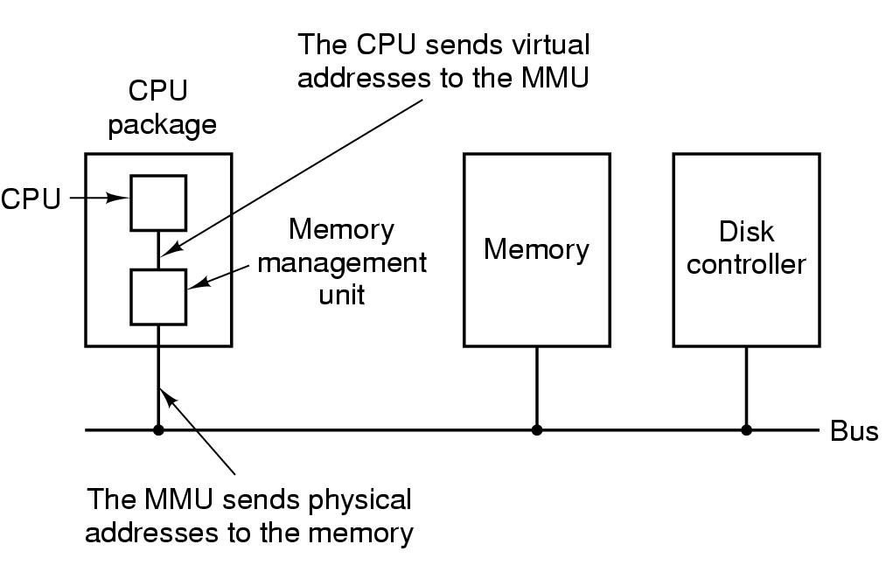
Virtual Memory Memory Management Unit (MMU)
Tanenbaum, Fig. 3-8.

Slide 43
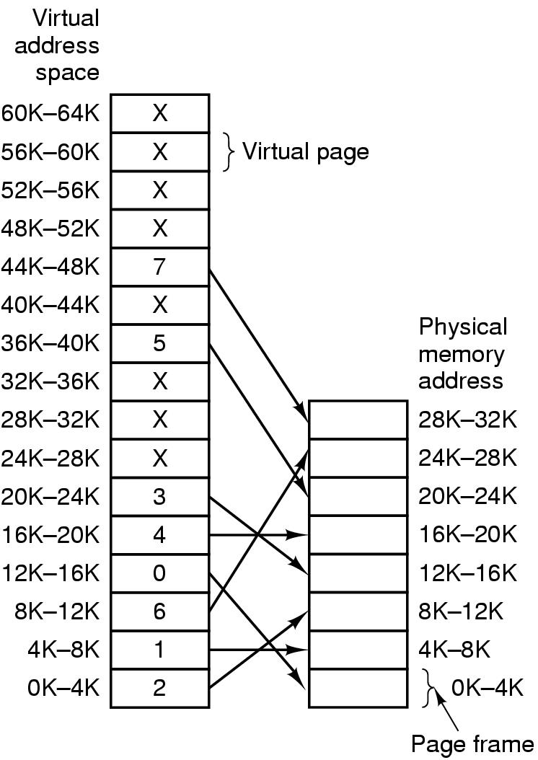
Virtual Memory Paging
Virtual address space
Is divided into fixed-size units called pages
pages from 0 to AddressSpaceSize / PageSize - 1
The physical memory
Is divided up into units of the same size corresponding in the physical memory called page frames
page frames from 0 to PhysicalMemSize / PageFrames - 1
Pages and frames are the same size
PageSize is typically be a value between 512 bytes and 64KB
Transfers between RAM and disk are in units of a page
Tanenbaum, Fig. 3-9.

Slide 44
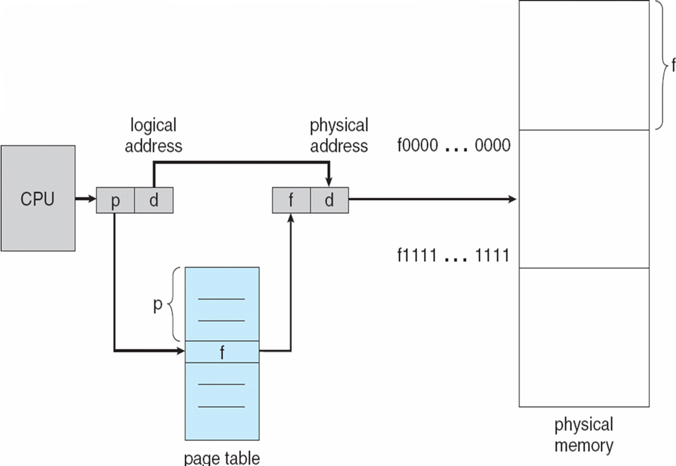
Virtual Memory Paging
In traditional, the paging has been handled by hardware
The virtual (logical) address is divided into 2 parts
a virtual page (p)
a page offset (d)
The p is used indexed into the page table that maps the page frame (f) in memory
The f is combined with d to define the physical memory address

Slide 45
Virtual Memory Paging – General formula
Assume
s is a page size
[p] = virtual address/s
→ d = virtual address – p x s
f is a page frame mapping page p
→ physical addr = f x s + d
Tanenbaum, Fig. 3-9.

Slide 46
Virtual Memory Paging
move REG, 0
→ move REG, 8192
virtual address 0 is sent to the MMU
= (virtual page 0, offset 0)
virtual page 0 mapping is page frame 2
physical address 8192 (8K)
= (page frames 2, offset 0)
→Memory processes at address 8192
move REG, 20500
→ move REG, 12308
virtual address 20500 (20K)
= (virtual page 5, offset 20)
virtual page 5 mapping is page frame 3
physical address 12308 (12K)
= (page frame 3, offset 20)
Tanenbaum, Fig. 3-9.
Notes:
46

Slide 47
Virtual Memory Paging
Problems
Only some virtual pages are mapped onto physical memory (e.g 16 pages maps 8 page frames)
→ virtual address space is larger than the physical memory
Present/Absent bit
Keeps track of which pages are physically present in memory
Page fault
a trap into the OS because of a reference to an address located in a page not in memory
generated by the MMU
result in a swap between physical memory and disk
the referenced page is loaded from disk into memory
the trapped instruction is re-executed

Slide 48
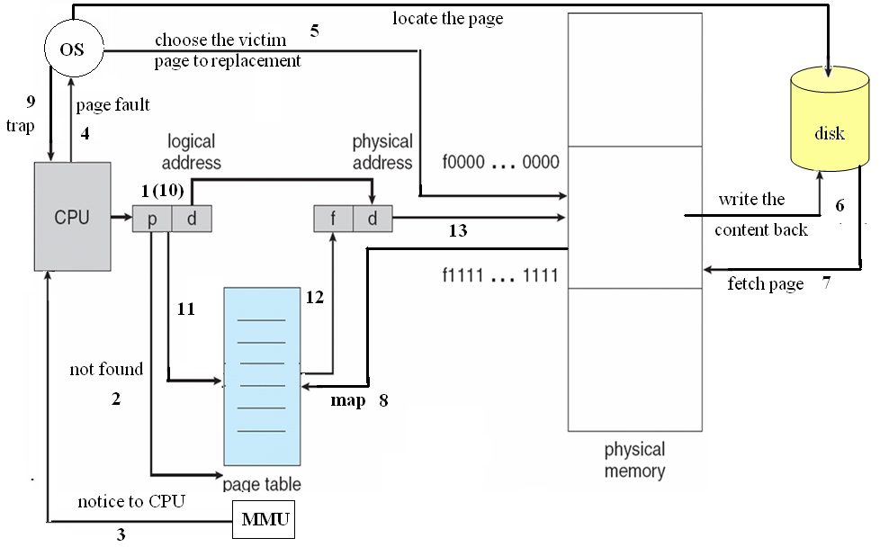
Virtual Memory Paging

Slide 49
Virtual Memory Paging
Example
MOV REG, 32780 (32K)
virtual address 8
=(virtual page 8, offset 12)
virtual address 8 is unmapped with any page frame
→ the page fault is executed
OS decided to evict page frame 1
OS load page 8 at page frame 1 and make to changes to the MMU map
OS re-executed the instruction
virtual address 8 mapping is page frame 1
physical address 4108 (4K)
(page frame 1, offset 12)
Tanenbaum, Fig. 3-9.

Slide 50
Virtual Memory Page Tables
The mapping of virtual addresses onto physical addresses can be summarized as following
The virtual address is split into a virtual page number (high-order bits) and offset (low-order bits)
Ex: 16 bit address and a 4KB page size, 4 bit for 16 pages and 12 bit offset (0 to 4095)
The virtual page number is used as an index into page table to find the entry for that virtual page
From the page table entry, the page frame number is found
The page frame number is attached to the high-order end of the offset, replacing the virtual page number, to form a physical address
Is the function with page number is argument and the page frame as result
Each process needs its own page table

Slide 51
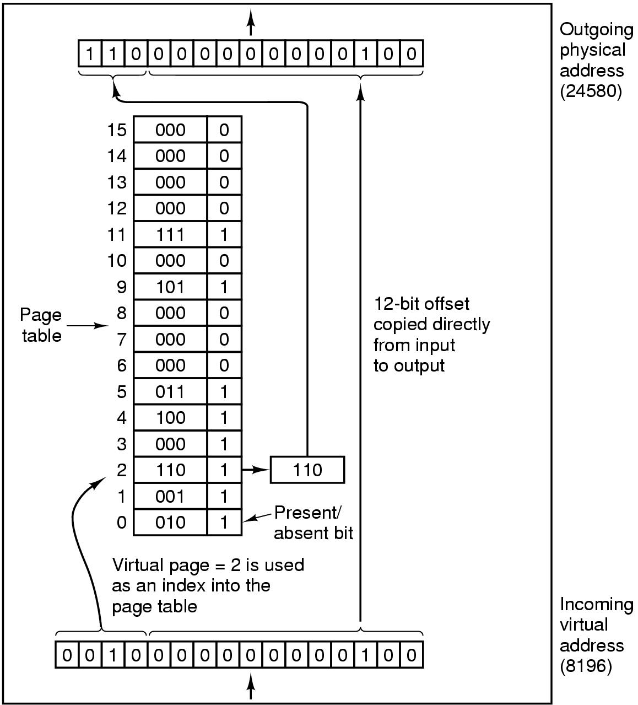
Virtual Memory Page Tables – Example
using page size is a power of 2
16 bit virtual address is split into a 4 bit page numbers (16 page) and 12 bit offset (4096 byte address)
MOV REG, 8196
8196 in binary 0010000000000100
0010 = page number
000000000100 = offset
=(virtual page 2, offset 4)
Physical address 24580 (24K)
(page frame 6, offset 4)
Tanenbaum, Fig. 3-10.

Slide 52
Virtual Memory Speeding up Paging
Paging issues
The mapping from virtual address to physical address must be fast
Avoid bottleneck
If an instruction execution takes 1 nsec, the page table lookup must be done in under 0.2 nsec
If the virtual address space is large, the page table will be large
32 bit virtual address, 4 KB page sizes → 1 million pages (entries)
Simplest design
Have a single page table consisting of an array of fast registers, with one entry for each virtual page, indexed by virtual page number
Page table is loaded from memory into registers (at starting up)
No more memory references needed (when processing)
Advantages: no memory
Disadvantages:
Context switch is expensive (load entire table for each process)
Can apply to the small page table

Slide 53
Virtual Memory Speeding up Paging – Example
If there are 64 pages and the page size is 2048 words, what is the length of logical address?
64 pages = 2⁶ → 6 bits is used to manage number of page
2048 words = 2¹¹ → 11 bits used to manage page size
→ 17 bits are a result
If there are 128K pages and the page size is 32 K words, what is the length of logical address?
128K pages = 2¹⁷ → 17 bits is used to manage number of page
32K words = 32.768 words = 2¹⁵ → 15 bits used to manage page size
→ 32 bits are a result

Slide 54
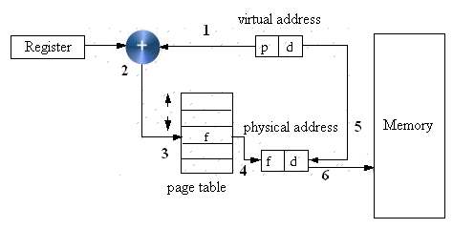
Virtual Memory Speeding up Paging
Single Register
Page table can be entirely in memory
A single register points to the start of page table
This register may be located in PCB
When the process start, this register must be reloaded
This allows the virtual to physical map to be changed at a context switch by reloading one register
Advantages: Context switch is fast (reloaded one register)
Disadvantages: more references to the memory for reading page table entries (slow)

Slide 55
Virtual Memory Translation Lookaside Buffers (TLB)
Problem
The CPU makes a memory access using a virtual address. It requires an address translation to a real address
This needs accesses to the page table which is itself in memory i.e. every virtual memory access requires two (or more if 2 level table) real accesses
→Slow
Observations
Keeping the page tables in memory reduce drastically the performance
Make large number of references to a small number of pages
Solution: using TLB or associative memory
A small fast hardware for mapping virtual addresses to physical addresses without going through the page table
This device is usually inside in MMU and consists of a small number of entries (usually less than 64) → maps only a small number of virtual pages
A TLB entry contains information about one page (valid bit (that presents the page in use or not use), page number, modified bit, protection bit, page frame)
These fields have a one-to-one correspondence with the fields in page table, except for the page number, which is not need in the page table
A TLB can be also implemented in software

Slide 56
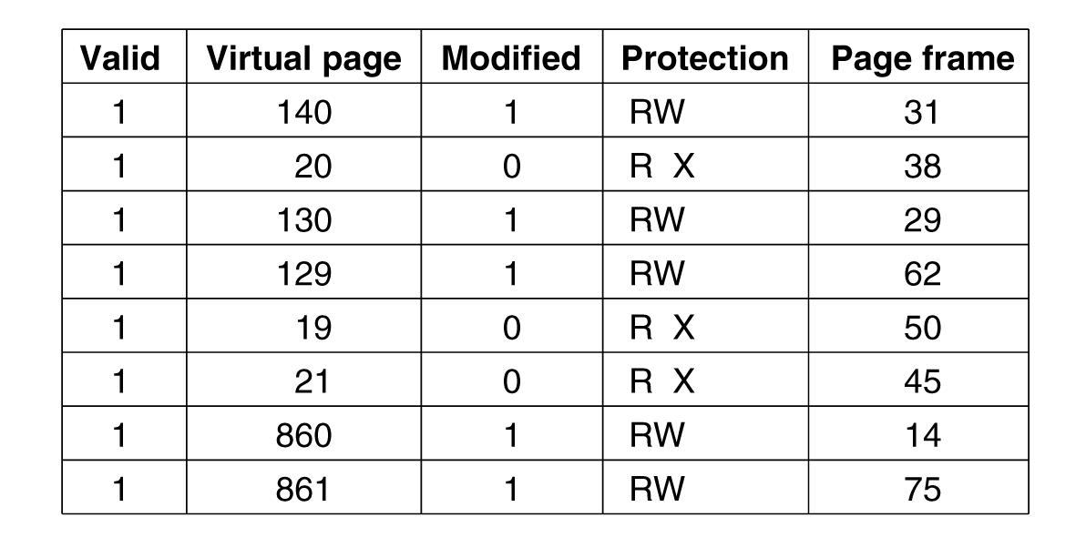
Virtual Memory Translation Lookaside Buffers (TLB)
Tanenbaum, Fig. 3-12.

Slide 57
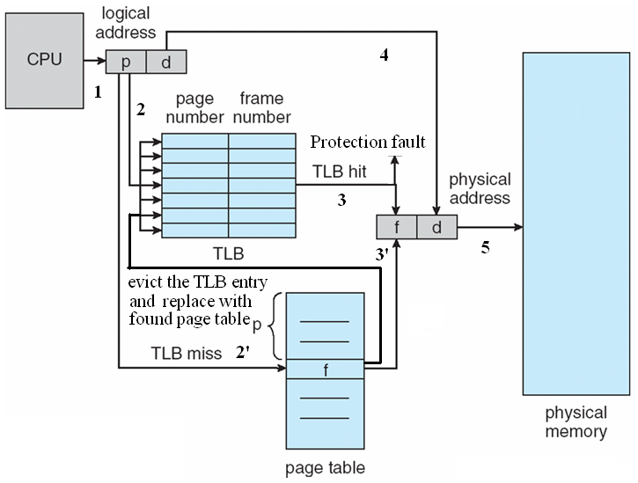
Virtual Memory Translation Lookaside Buffers (TLB)
How to the TLB do

Slide 58
Virtual Memory Translation Lookaside Buffers (TLB)
How to the TLB do (cont)
When the virtual address is presented in MMU for translation
The hardware search entire TLB to find if the entry is matched
If so,
If the access does not violate the protection, the page frame is taken without going to the page table
Otherwise, the protection fault can occur
Otherwise,
The MMU detects the miss and does an ordinary page table lookup
The MMU evicts one of the entries from the TLB and replaces it with the page table just looked up
After the page frame is defined, the physical memory can be accessed

Slide 59
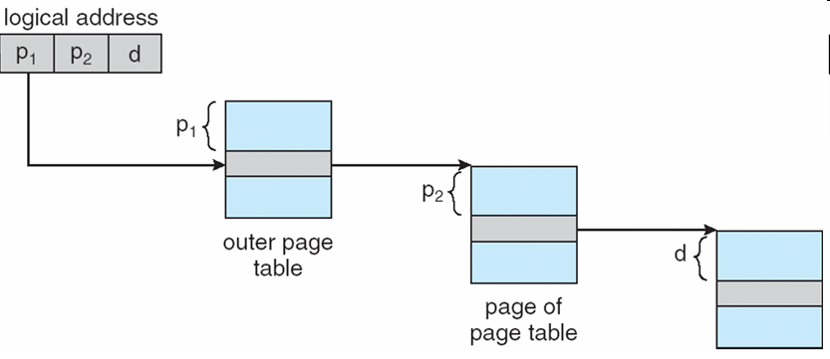
Virtual Memory Multilevel Page Tables
Problem
Most modern computer support a large logical address (2³² to 2⁶⁴)
→ The page table become excessive large and the developer would not want to allocate it in memory at a/ all time
Solution
Divide the page table into smaller pieces
The multilevel Page tables is used
To avoid keeping all the page tables in memory all the time
The main idea is “Paging the page table”
The virtual address is divided two part: 20 bit page number, and 12 bit offset
Since the page table is paged again, the page number is divided two into: 10 bit page number (PT1), and 10 bit offset (PT2)

Slide 60
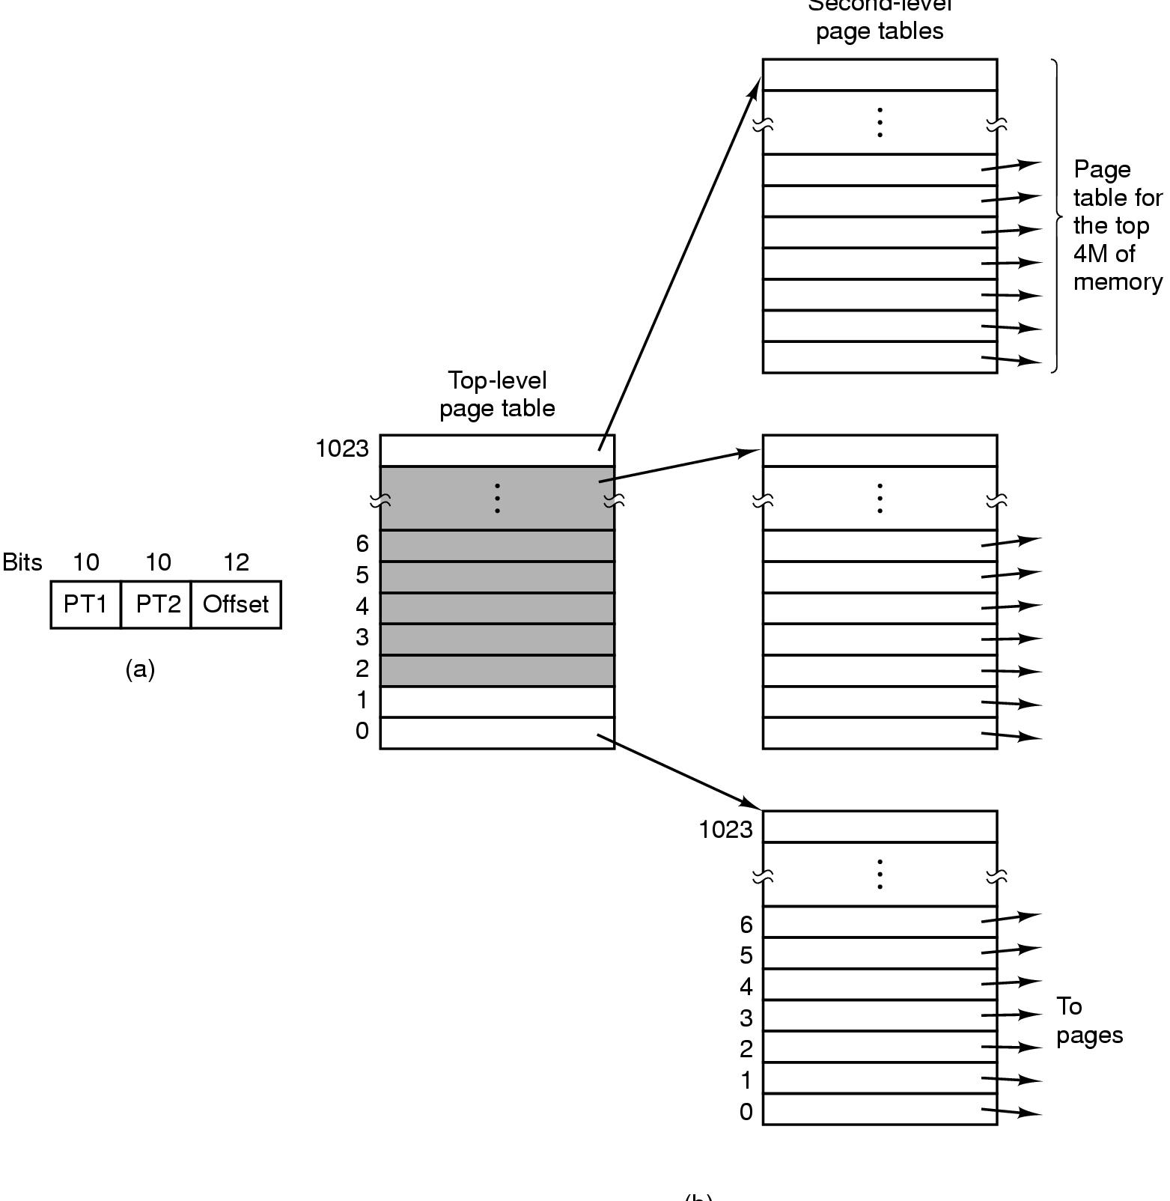
Virtual Memory Multilevel Page Tables
32 bit virtual addresses
10 bits – PT1
10 bits – PT2
12 bits – offset
Page size = 4KB
No. of pages = 2¹⁰
Top-level page table – 1024 entries
An entry → 4MB
Second-level page table – 1024 entries
An entry → 4KB
Tanenbaum, Fig. 3-13.

Slide 61
Virtual Memory Multilevel Page Tables
How does it work
First, the MMU extracts the PT1 field and uses this value as an index into the top level page table
The entry located by indexing into the top-level page table yields the address or page frame number of a second-level page table
The PT2 field is used as an index into the selected second-level page table to find the page frame number for the page itself
Ex:
32 bit virtual address 0x00403004 (=4.206.596), 12.292 bytes data
PT1=1 → 4M:8M (=4.194.304 bytes)
PT2=3 → 12KB:16KB(=12.288 byte : 16383 bytes)
The virtual address is (4.194.304+12.288 = 4.206.592 to 4.210.687) and Offset = 4
→The page frame PT1 = 1, The page frame of PT2 = 0, thus the physical address is 4
If the page is not in memory, causing a page fault
If the page is in memory, the page frame number taken from the second level page table combined with the offset to construct the physical address

Slide 62
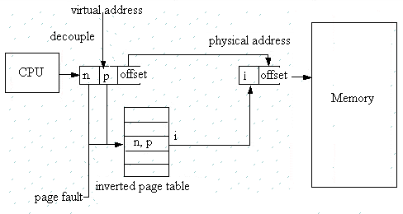
Virtual Memory Inverted Page Table

Slide 63
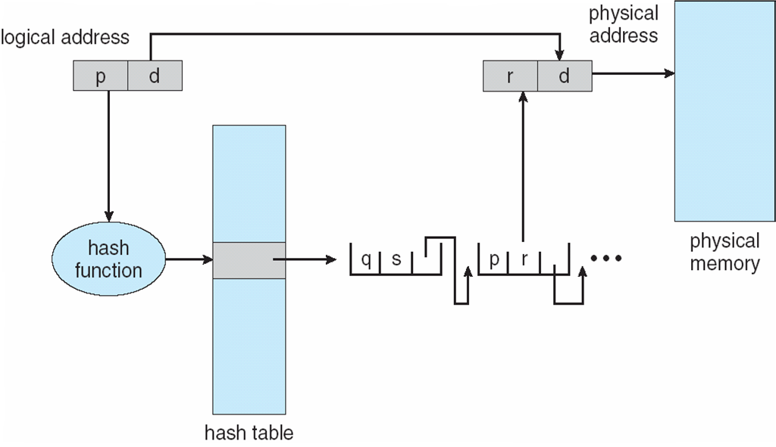
Virtual Memory Inverted Page Table
Advantages
64bit virtual addresses, a 4KB page, 1GB RAM, an inverted table only required 262,144 entries (saving vast amount of space)
Disadvantages
The virtual-to-physical translation becomes much harder and slower
Searching the entire table at every memory reference
Practically: use of TLB and hash tables (searching in software)

Slide 64
Memory Management Page Replacement Algorithms

Slide 65
Review
Memory Abstractions
Multiple processes locate in memory (both primary and secondary)
Base and Limit Registers
Multiple processes locate in memory and protection
Base contains the first address of process in memory, Limit contains the length of process, the process owns private address space
Disadvantages
External fragmentation (Defragment)
Slow
Swapping
Multiple processes with ready processes locate in memory and passive processes locate in HDD – swap file area
Swap out/ in operator
Disadvantages
External fragmentation
Process can not grow in memory and the swap area on the disk is full → data segment upward, stack segment downward

Slide 66
Review
Memory Abstractions
Memory Management with Bitmaps
The memory divides units with same size that has a bit corresponding bit in the bitmap (0: free, 1: occupied)
Disadvantages
Slow when searching the bitmap to find a run of k consecutive 0 bits in the map (small)
Internal fragment (large size)
Memory Management with Linked Lists
Maintain a linked list of allocated (P) and free memory (H)
Allocating algorithms
First, Next, Best, Worst, Quick Fit
Virtual Memory
Software/ Process sizes larger than memory
Overlays
Developer splits program to many overlays
Disadvantages: developer‘s knowledge is important

Slide 67
Review
Memory Abstractions
Virtual Memory
Paging
Address space is broken up into pages
Physical memory is divided up into page frames
Virtual address vs. Physical address, manage address space with bit
MMU transfers Virtual address → p, d; then it looks up page table following the index to get the page frame; the page frame combines with d to determine the physical address
Page fault: the program references a part of its address space that is not in physical memory
Page table
Load to collection registers, load to memory using base register, using TLB
Excessive large page table: multilevel page, inverted page table, inverted page table with hash or TLB
Entry: Caching disabled, Referenced, Modified, Protection, Present/absent, page frame number

Slide 68
Page replacement algorithms Problems
At page fault and full physical memory
Space has to be made
A currently loaded virtual page has to be evicted from memory
Choosing the page to be evicted
Not a heavily used page → reduce the number of page faults
Page replacement
The old page has to be written on the disk if it was modified
The new virtual page overwrite the old virtual page into the page frame

Slide 69
Page replacement algorithms Optimal
Each page can be labeled with the number of instructions that will be executed before that page is first reference
Choose the page that will be the latest one accessed in the future between all the pages actually in memory
Very simple and efficient (optimal)
Impossible to be implemented in practice
there is no way to know when each page will be referenced next
It can be simulated
At first run collect information about pages references
At second run use results of the first run (but with the same input)
It is used to evaluate the performance of other, practically used, algorithms

Slide 70

Page replacement algorithms Optimal
Ex:
a memory with free three frames
7 0 1 2 0 3 0 4 2 3 0 3 2 1 2 0 1 0 7 0 1
Number of page faults are 9 times
Number of page hits are 12 times
→ minimum of page fault is at least size of page frame that is allocated to process
→ principles: more and more page frame is allocated, less and less page fault occurs

Slide 71
Page replacement algorithms Not Recently Used (NRU)
Each page has two status bits associated
Referenced bit (R)
Modified bit (M)
The two bits
updated by the hardware at each memory reference
once set to 1 remain so until they are reset by OS
can be also simulated in software when the mechanism is not supported by hardware
Algorithms
At process start the bits are set to 0
Periodically (on each clock interrupt) the R bit is cleared
For page replacement, pages are classified
Class 0: not referenced, not modified
Class 1: not referenced, modified
Class 2: referenced, not modified
Class 3: referenced, modified
The algorithm removes a page at random from the lowest numbered nonempty class
It is easy to understand, moderately efficient to implement, and gives an adequate performance

Slide 72
Page replacement algorithms Not Recently Used (NRU) – Example
A computer has four page frames. The time of loading, time of last access, and the R and M bits for each page are as shown below (the times are in clock ticks). Which page will be replaced?
The page 0 is replaced
Page | Loaded | Last Reference | R | M
0 | 226 | 280 | 0 | 0
1 | 160 | 265 | 0 | 1
2 | 110 | 270 | 1 | 0
3 | 120 | 285 | 1 | 1

Slide 73

Page replacement algorithms First-In, First-Out (FIFO)
OS maintains a list of all pages currently in memory, with
the most recent arrival at the tail
the least recent arrival at the head
On a page fault, the page at the head is removed and the new page added to the tail of the list
It’s rarely used
Ex:
a memory with free three frames
7 0 1 2 0 3 0 4 2 3 0 3 2 1 2 0 1 0 7 0 1

Slide 74
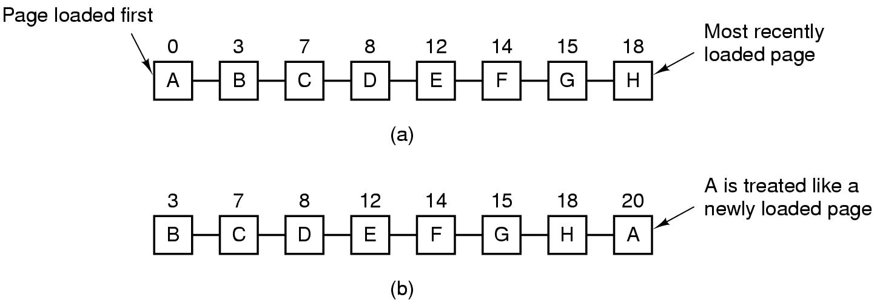
Page replacement algorithms Second-Chance
A modification of FIFO to avoid throwing out a heavily used page
Inspect the R bit of the oldest page
0 → page is old and unused → replaced
1 → page is old but used → its R bit = 0 and the page is moved at the end of the queue as a new arrived page
Look for an old page that has not been not referenced in the previous clock interval
If all the pages have been references → FIFO
Tanenbaum, Fig. 3-15.

Slide 75
Page replacement algorithms Second-Chance – Example
A computer has four page frames. The time of loading, time of last access, and the R and M bits for each page are as shown below (the times are in clock ticks). Which page will be replaced?
The page 1 is replaced
Page | Loaded | Last Reference | R | M
0 | 226 | 280 | 0 | 0
1 | 160 | 265 | 0 | 1
2 | 110 | 270 | 1 | 0
3 | 120 | 285 | 1 | 1

Slide 76
Page replacement algorithms Clock
In a second chance algorithms, it is unnecessarily inefficiency because it is constantly moving pages around on its list
Keep all the page frames on a circular list in the form of a clock
The hand points to the oldest page
How to work
When a page fault occurs, the page being pointed to by the hand is inspected
If its R bit is 0, the page is evicted, the new page is inserted into the clock in its place, and the hand is advanced one position
If R is 1, it is cleared and the hand is advanced to the next page

Slide 77
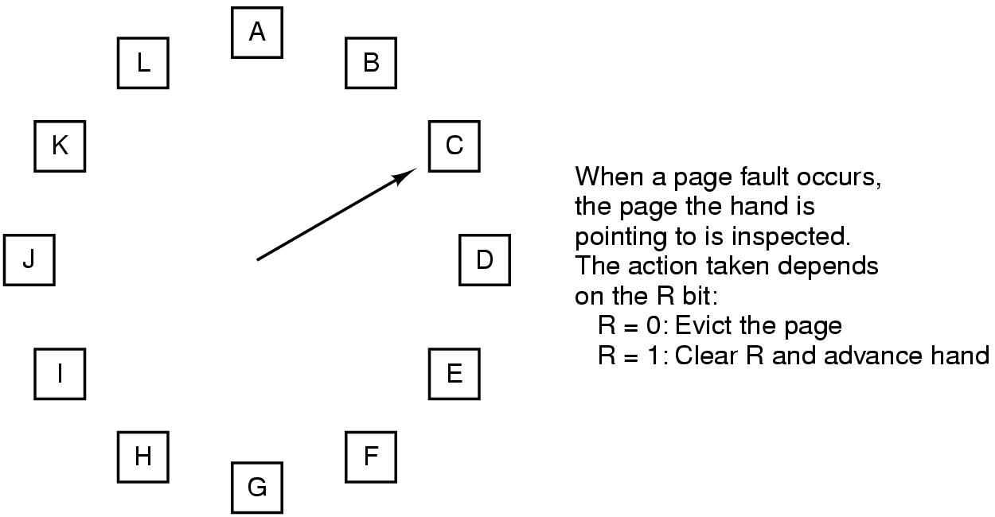
Page replacement algorithms Clock
Tanenbaum, Fig. 3-16.

Slide 78
Page replacement algorithms Least Recently Used (LRU)
Based on the observation that
pages that have been heavily used in the last few instructions will probably be heavily used again in the next few
Throw out the page that has been unused for the longest time when a page fault occurs
The algorithm keeps a linked list
the referenced page is moved at the front of the list
the page at the end of the list is replaced
the list must be updated at each memory reference → costly
Implementing LRU with a hardware counter
keep a 64-bit counter which is incremented after each instruction
each page table entry has a field large enough to store the counter
the counter is stored in the page table entry for the page just referenced
the page with the lowest value of its counter field is replaced
Implementing LRU with a hardware bits matrix
N page frames → N x N bits matrix
when virtual page k is referenced
bits of row k are set to 1
bits of column k are set to 0
the page with the lowest value is removed

Slide 79

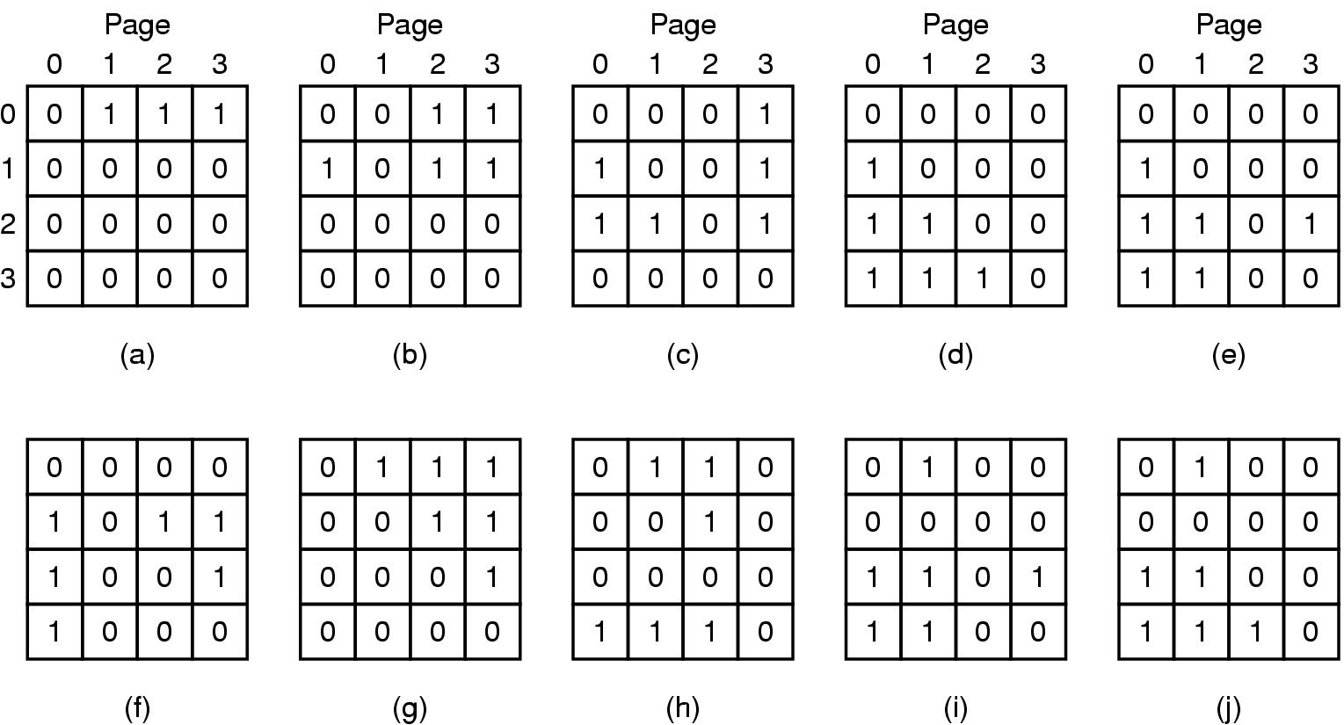
Page replacement algorithms Least Recently Used (LRU)
Ex:
a memory with free three frames
7 0 1 2 0 3 0 4 2 3 0 3 2 1 2 0 1 0 7 0 1
A memory with four page frames
0 1 2 3 2 1 0 3 2 3
Tanenbaum, Fig. 3-17.

Slide 80
Page replacement algorithms Least Recently Used (LRU) – Example
A computer has four page frames. The time of loading, time of last access, and the R and M bits for each page are as shown below (the times are in clock ticks). Which page will be replaced?
The page 1 is replaced
Page | Loaded | Last Reference | R | M
0 | 226 | 280 | 0 | 0
1 | 160 | 265 | 0 | 1
2 | 110 | 270 | 1 | 0
3 | 120 | 285 | 1 | 1

Slide 81
Page replacement algorithms Not Frequently Used (NFU)
A software implementation of LRU
A software counter associated with each page (initially 0)
At each clock tick the R bit is added to the counter for all the pages in memory; after that the R bits are reset to 0
The page with the lowest counter is chosen when a page fault occurs
Problem:
The useful pages are evicted
The bit reference is useful to count the page to be reference, but it is not known the order of reference

Slide 82
Page replacement algorithms Aging
A software implementation of LRU
modification of NFU
Shift right the counter one position
R bit is added to the leftmost bit
The page whose counter is the lowest is removed when a page fault occurs
Differences from LRU
does not know the page which was referenced first between two ticks; for example pages 3 and 5 at step (e)
the finite number of bits of counters → does not differentiate between pages with the value 0 of their counter

Slide 83
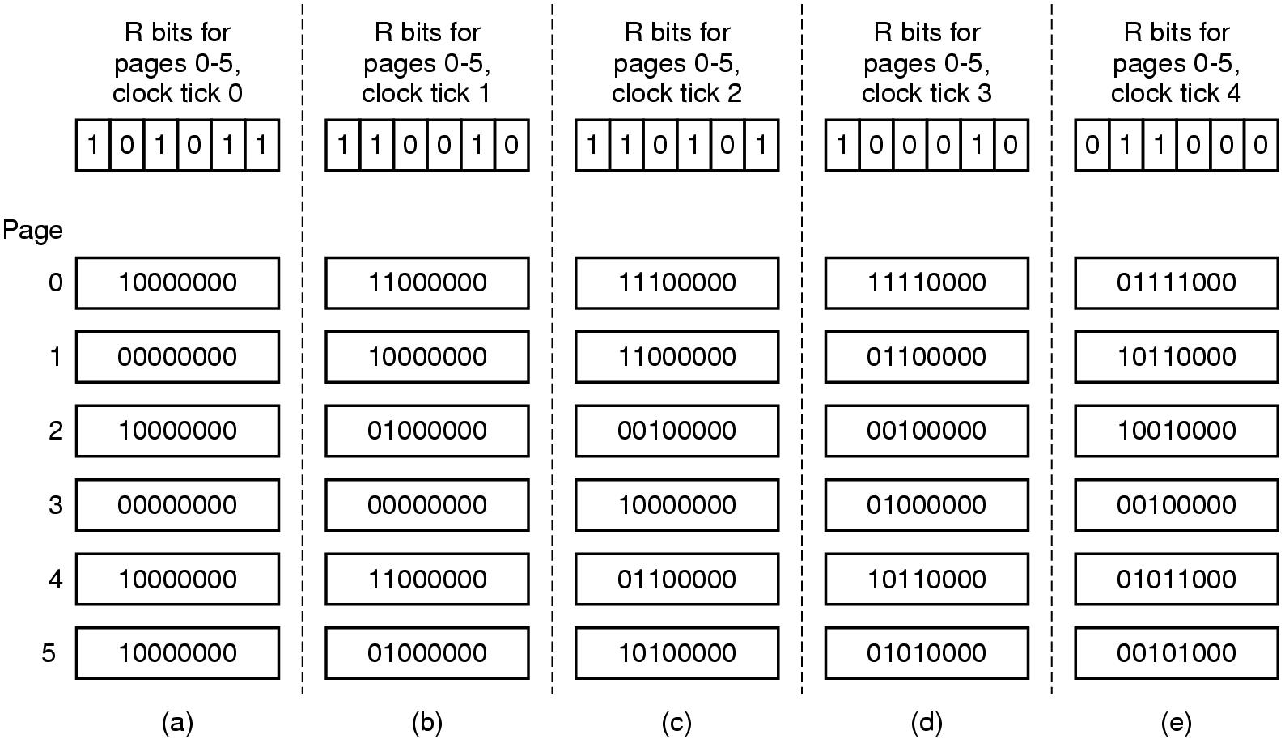
Page replacement algorithms Aging
Tanenbaum, Fig. 3-18.

Slide 84
Page replacement algorithms Thrashing
A program causing page faults every few instructions
A process is not allocated enough page frames as its requirements
→ Many processes are located in memory, thus, each process is allocated at least page frames
→ The page replacement takes more time (than execution)
→ The CPU utilization is decreased and some new process is loaded in the memory
The impact of thrashing on system
The system can be hanged
The process can not continually progress
Solution
Allocating enough page frame (!?) to the process
How to know the process need the number of page frame in progress

Slide 85
Page replacement algorithms Locality of Reference
The process references only a relatively small fraction of its pages in execution
A small fraction is a set of pages that a process is currently using
The process moves from small fractions (that is needed in execution in time) to others
The process involves many small fractions that can intersected

Slide 86
Page replacement algorithms Demand paging vs. Prepaging
Demand paging: Pages are loaded only on demand
Processes are started up with none of their pages in memory
CPU tries to fetch the first instruction → page fault
Prepaging
Loading the pages before letting processes run
Loading the pages before resuming the process

Slide 87
Page replacement algorithms Working Set
The set of pages that a process is currently using
If the entire working set is in memory, the process will run without causing many faults until it moves into another execution phase
Working set can changes over time
Problems
If the available memory is too small to hold the entire working set, the process will cause many page faults and run slowly → thrashing
The process will just cause page faults until its working set has been loaded → slow, waste considerable CPU time
Solutions
Using working set model

Slide 88
Page replacement algorithms Working Set Model
Keep track of each process’s working set and make sure that it is in memory before letting the process run (prepaging)
Reduce the page fault rate (avoid thrashing)
Is implemented as
OS keeps track of which pages are in the working set
When a page fault occurs, find a page not in the working set and this page is located in
R bit is examined.
If R’s value is 1, the current virtual time is written into the Time of last use field
If R’s value is 0, the page may be a candidate to removal
The age (the current virtual time – its Time of last use) is computed and compared with τ (span multiple clock ticks).
If age > τ, the page is no longer in the working set, and the new page replaces it
Otherwise, the page is still in the working set
If the entire table is scanned without finding the candidate to evict and one or more pages with R = 0 is founds, the one with the greatest age is evicted. Otherwise, the chosen random is executed (R = 1)

Slide 89
Page replacement algorithms WSClock
Problem
Working set algorithm is cumbersome, since the entire page table has to be scanned at each page fault until a suitable candidate is located
WSClock
Improved WS algorithm is based on the clock algorithm
Simplicity of implementation and good performance
A circular list of page frames is used
How it works
This list is empty (initially)
The page is loaded, it is added to the list to form a ring (with Time of last use field and R bit)
As with the clock program, at each page fault the page pointed to by hand is examined first
If R is set to 1, the page has been used during the current tick, then R set to 0, the hand advanced to next page
If R equals 0,
if the age is greater than τ and the page is clean, it is not in working set and a valid copy exists on disk. The page frame is simply claimed and the new page put there
If the page dirty, it cannot claim immediately (clean page is define base on write to disk scheduled)
Notes:
Cumbersome: cồng kềnh

Slide 90
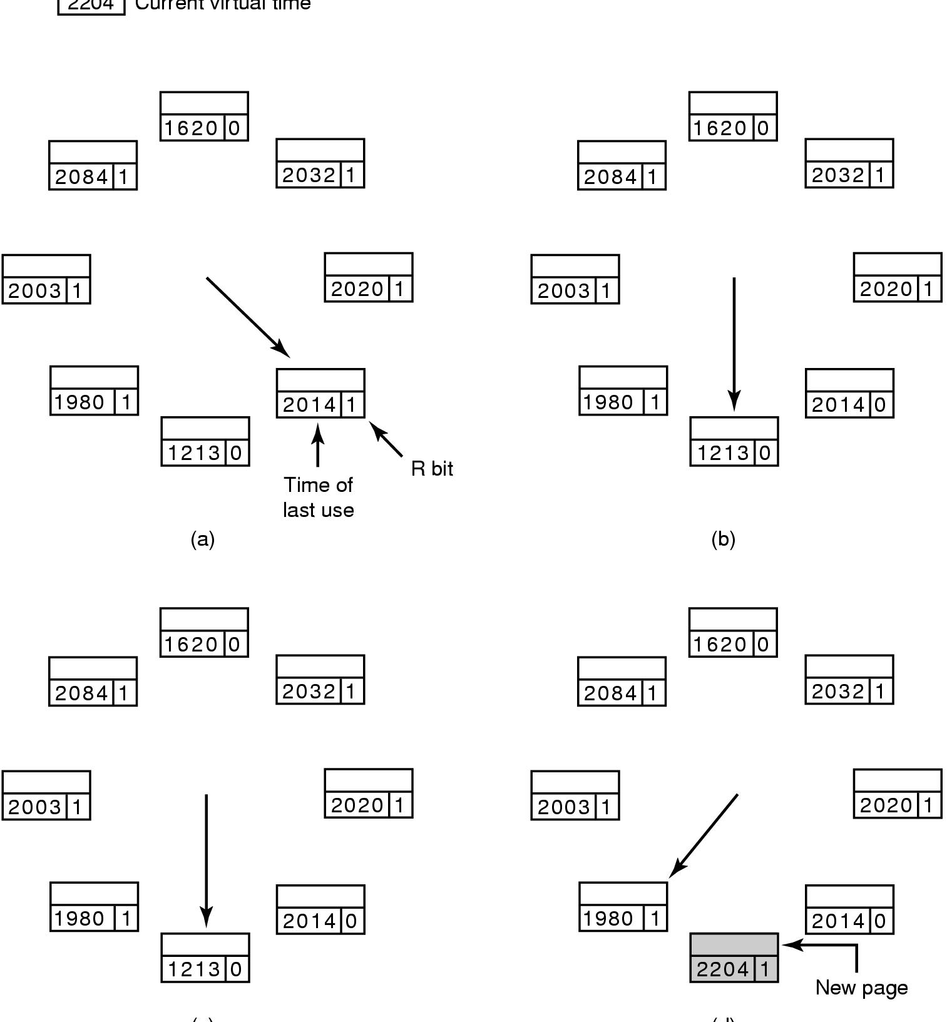
Page replacement algorithms WSClock
Tanenbaum, Fig. 3-21.

Slide 91
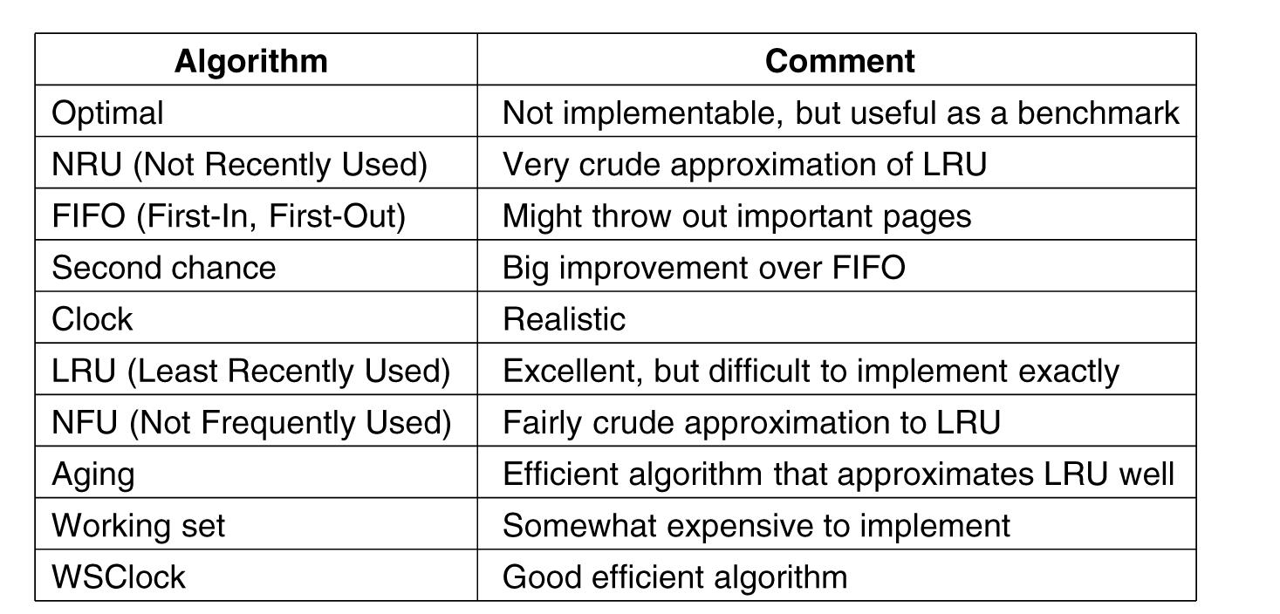
Page replacement algorithms Summary
Tanenbaum, Fig. 3-22.

Slide 92
Summary
Page replacement Algorithms
Q&A

Slide 93
Next Lecture
Design the Paging Systems

